Slide 1
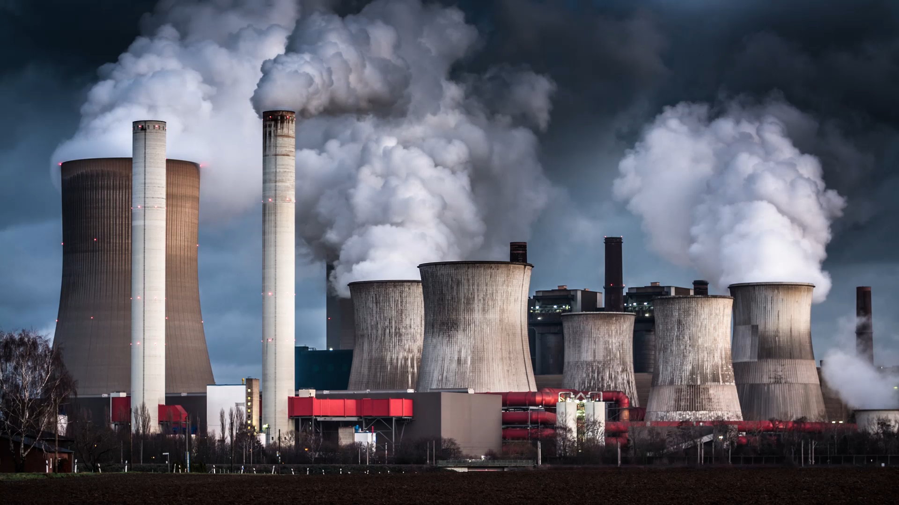
Environmental Protection, Occupational Health and Safety 13
Assoc. Prof. Dr. Fatma Tuğçe ŞENBERBER DUMANLI
fatma.senberber@nisantasi.edu.tr

Slide 2
END OF THE SEMESTER...
SUBJECTS:
Fire
Fire protection
Biological risk factors
Psychosocial risk factors
Basic protection methods in OHS
DATE: Follow the announcements about exam calendar on the website of Nişantaşı University.

Slide 3

Question -1
Which of the following is wrong regarding the hygiene measures to be taken in work related to work with biological risk factors?
A) Workers will not eat or drink in work areas where there is a risk of contamination of biological agents.
B) Workers will be provided with suitable protective clothing or other suitable special clothing.
C) Protective equipment will be stored properly in a specific place.
D) Washing and toilet facilities with suitable and sufficient cleaning materials such as eye wash liquids and skin antiseptics will be provided to the workers.
E) Trainings given to workers against biological risks are subject to a fee.
Notes:
E

Slide 4
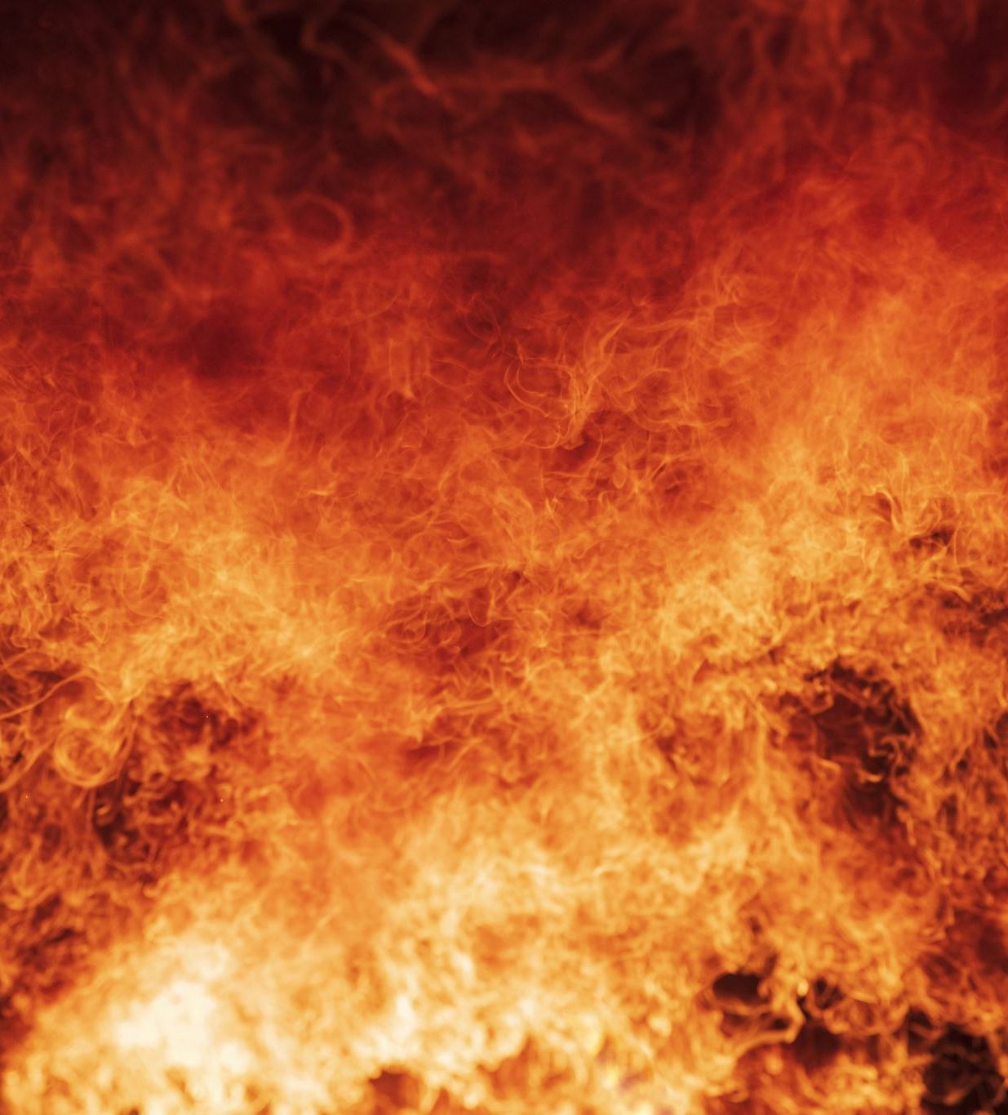
Question -2
According to the regulation on the protection of buildings from fire, which of the following is not a fire class?
A) Solid fires
B) Liquid fires
C) Gas fires
D) Chemical metal fires
E) Electric fires
Notes:
E

Slide 5

Question -3
Which factors must be together in order for the burning event to occur?
A) Nitrogen, oxygen, heat
B) Flammable material, oxygen, heat
C) Corrosive substance oxygen, heat
D) Flammable material, heat, flame
E) Corrosive substance, flame, heat
Notes:
B

Slide 6

Question -4
Which of the following is a situation that will not pose a psychosocial hazard in the workplace?
A) Efficient teamwork
B) Role conflict
C) Insufficient role
D) Role ambiguity
E) Mobbing
Notes:
A

Slide 7

Question -5
Which of the following is not a condition caused by exposure to biological risk factors?
A) Eye allergy
B) Hepatitis
C) COVID-19
D) Temporary hearing loss
E) Common cold
Notes:
D

Slide 8
Question -6
The situation where the employee cannot benefit from his / her skills and training
The situation where the employee is not sufficiently informed about his role in the job
The situation where the employee is asked to take on roles that are incompatible with each other
Which of the above refer to the following respectively?
A) Role inadequacy - Role conflict - Role ambiguity
B) Role conflict - Role ambiguity - Role insufficiency
C) Role insufficiency - Role ambiguity - Role conflict
D) Role ambiguity - Role conflict - Role insufficiency
E) Role conflict - Role insufficiency - Role ambiguity
Notes:
C

Slide 9

Question -7
Which of the following is not a sign of stress?
A) Depression, tension
B) Regular living
C) Find important things meaningless
D) Loss of motivation to do anything
E) Inability to focus on the subject
Notes:
B

Slide 10

Question -8
Which of the following is not mobbing?
A) Not allowing self-expression
B) Employment in unqualified jobs
C) Social isolation
D) Participation in decisions
E) Preventing communication
Notes:
D

Slide 11
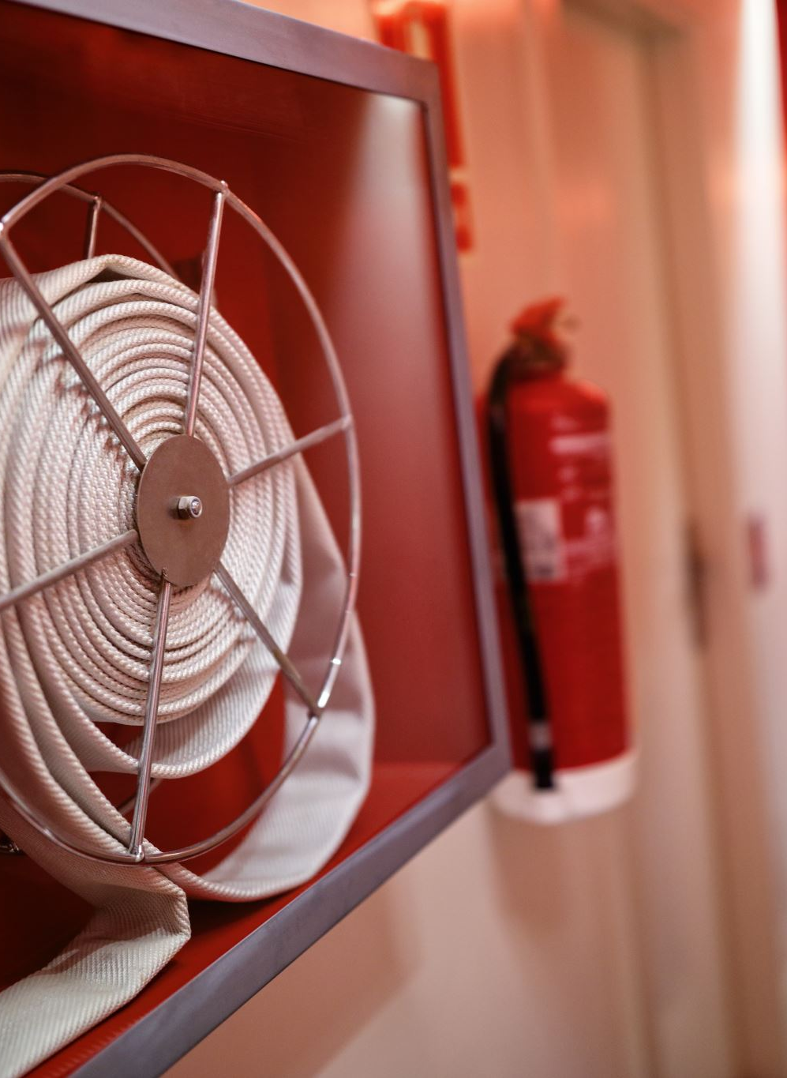
Question -9
Which of the following is not suitable to extinguish Class B liquid fires?
A) Fire extinguisher containing dry chemical powder
B) Fire extinguisher containing foam
C) Water
D) Fire extinguisher containing carbon dioxide
E) Sand
Notes:
C

Slide 12
Question -10
Which of the following is wrong about personal protective equipment (PPE)?
A) PPE must be suitable for the job to be used and must provide adequate protection.
B) PPE does not eliminate the danger, prevents or minimizes the adverse effect from the danger.
C) PPE selection varies according to the gender of the employee.
D) An employee who does not use PPE and continues not to use it despite being warned may be dismissed without compensation.
E) PPE use is the last choice in basic protection methods.
Notes:
C

Slide 13

GOOD LUCK ON YOUR EXAMS
☺

